Slide 1
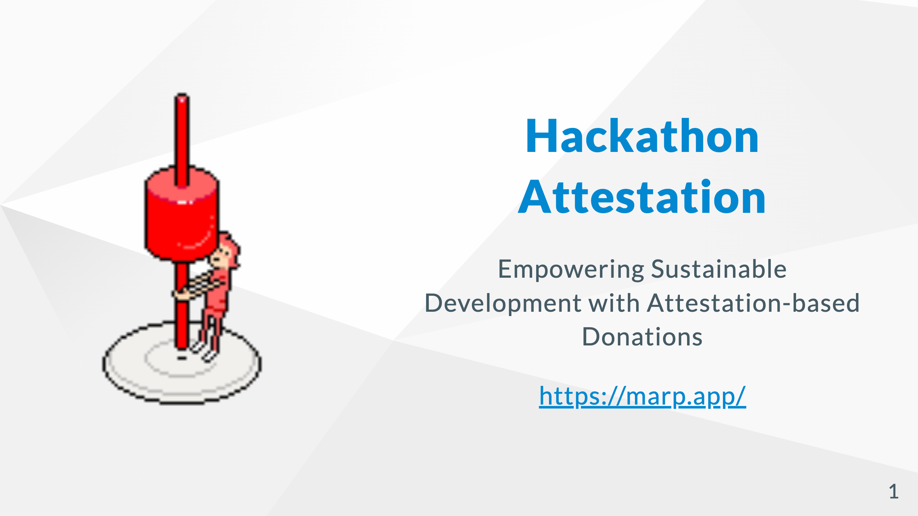
https://eth-global-tokyo-chi.vercel.app/
Notes:
Our product, named Hackathon Attestation, --- after hackathon events

Slide 2

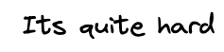
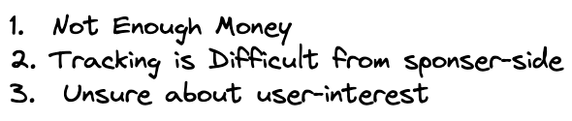
Notes:
Post hackathon development is quite hard! 😢 :

Slide 3
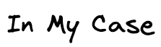
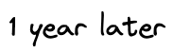
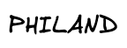
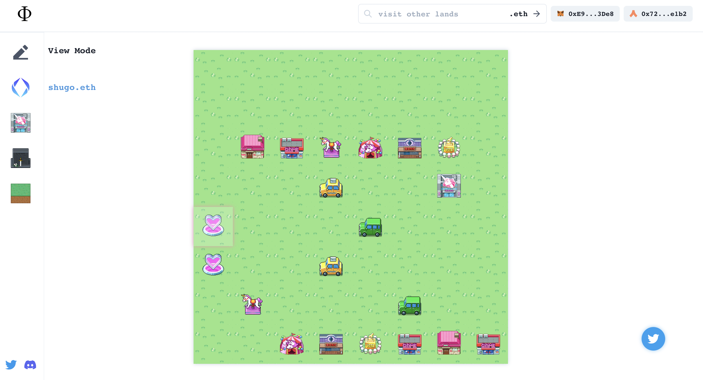


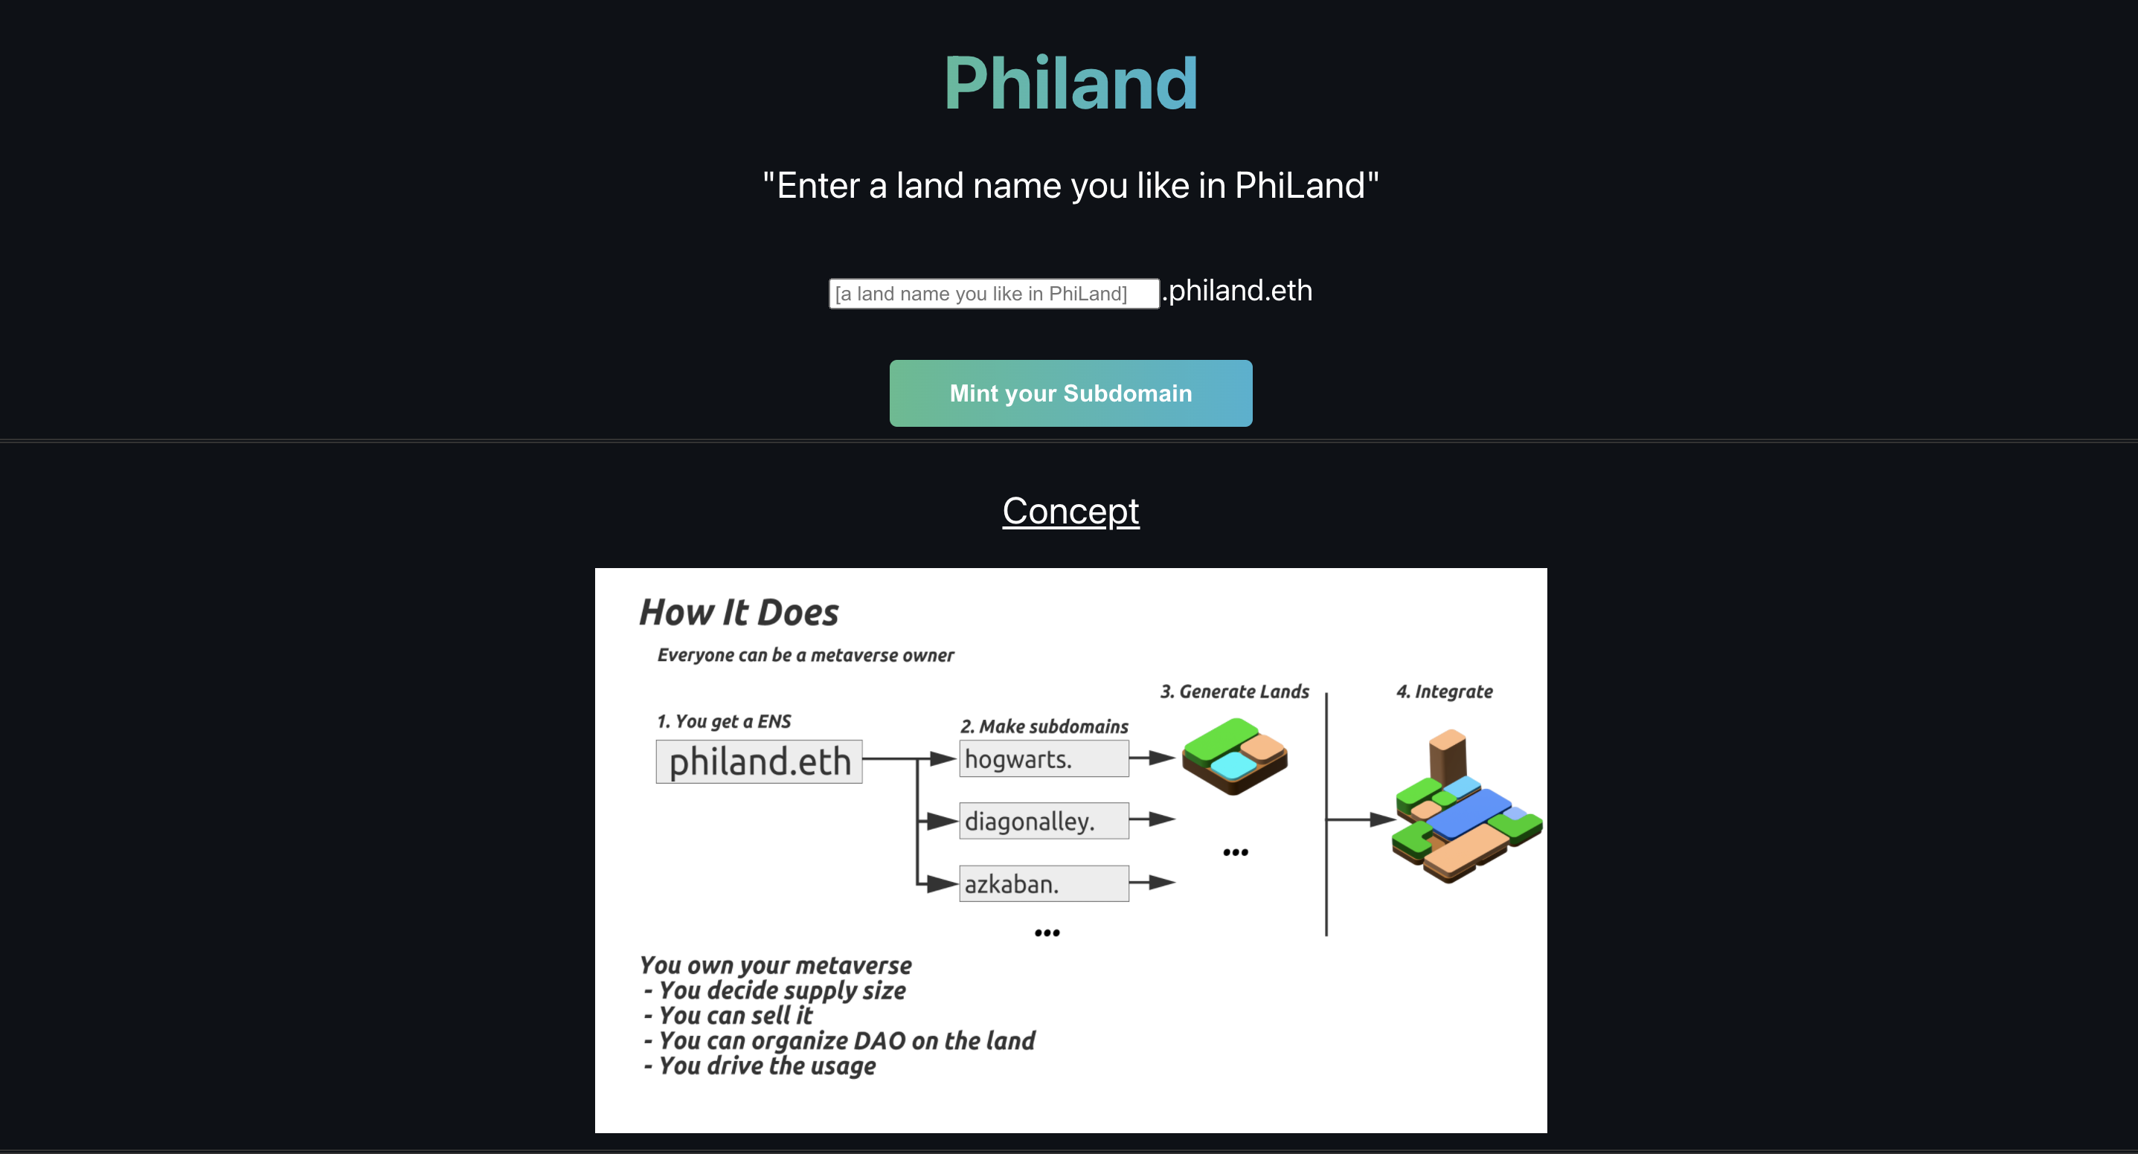
NFT HACK2022
https://ethglobal.com/showcase/phi-hs50f
BUILDQUEST
https://ethglobal.com/showcase/phi-land-2f6hf
Notes:
1 year ago, we joined a eth global hackathon too. Luckily, our team has succeeded in developing and collaborating until today.
Looking back these days, I found some crucial factors that have allowed us to keep working together so far:

Slide 4
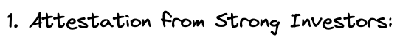


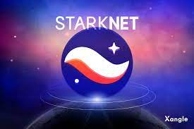
Notes:
1. investors have good connections with another investors and projects, so, its important to get trust from investors at hackathon
2. We got early donation from potential user, thanks to this, we measured user interest and expectations for our product
3. We got milestone-based grants from StarkNet . it migrates our financial worries and let us concentrate on development.

Slide 5

Bring the post-hackathon project closer to a similar env
Notes:
In this hackathon, my goal is to suggest a solution that Bring ing the post-hackathon project closer to a similar. conditions I’ve encountered

Slide 6


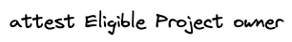
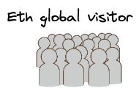
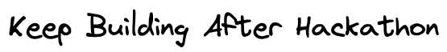
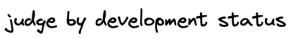


Notes:
We propose the following steps for post-hackathon assistance:
The product owner defines milestones and. deadlines.
Sponsors provide an endorsement for the project.
Users contribute donations with attestation
Product owner keep developing
At the deadline, a vote takes place to decide if the milestone is achieved or not
If the vote approves, product owner can access the total amount of donations .

Slide 7
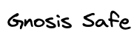
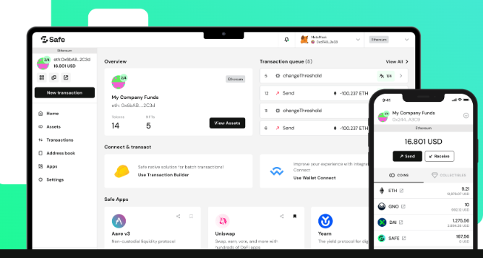
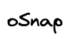
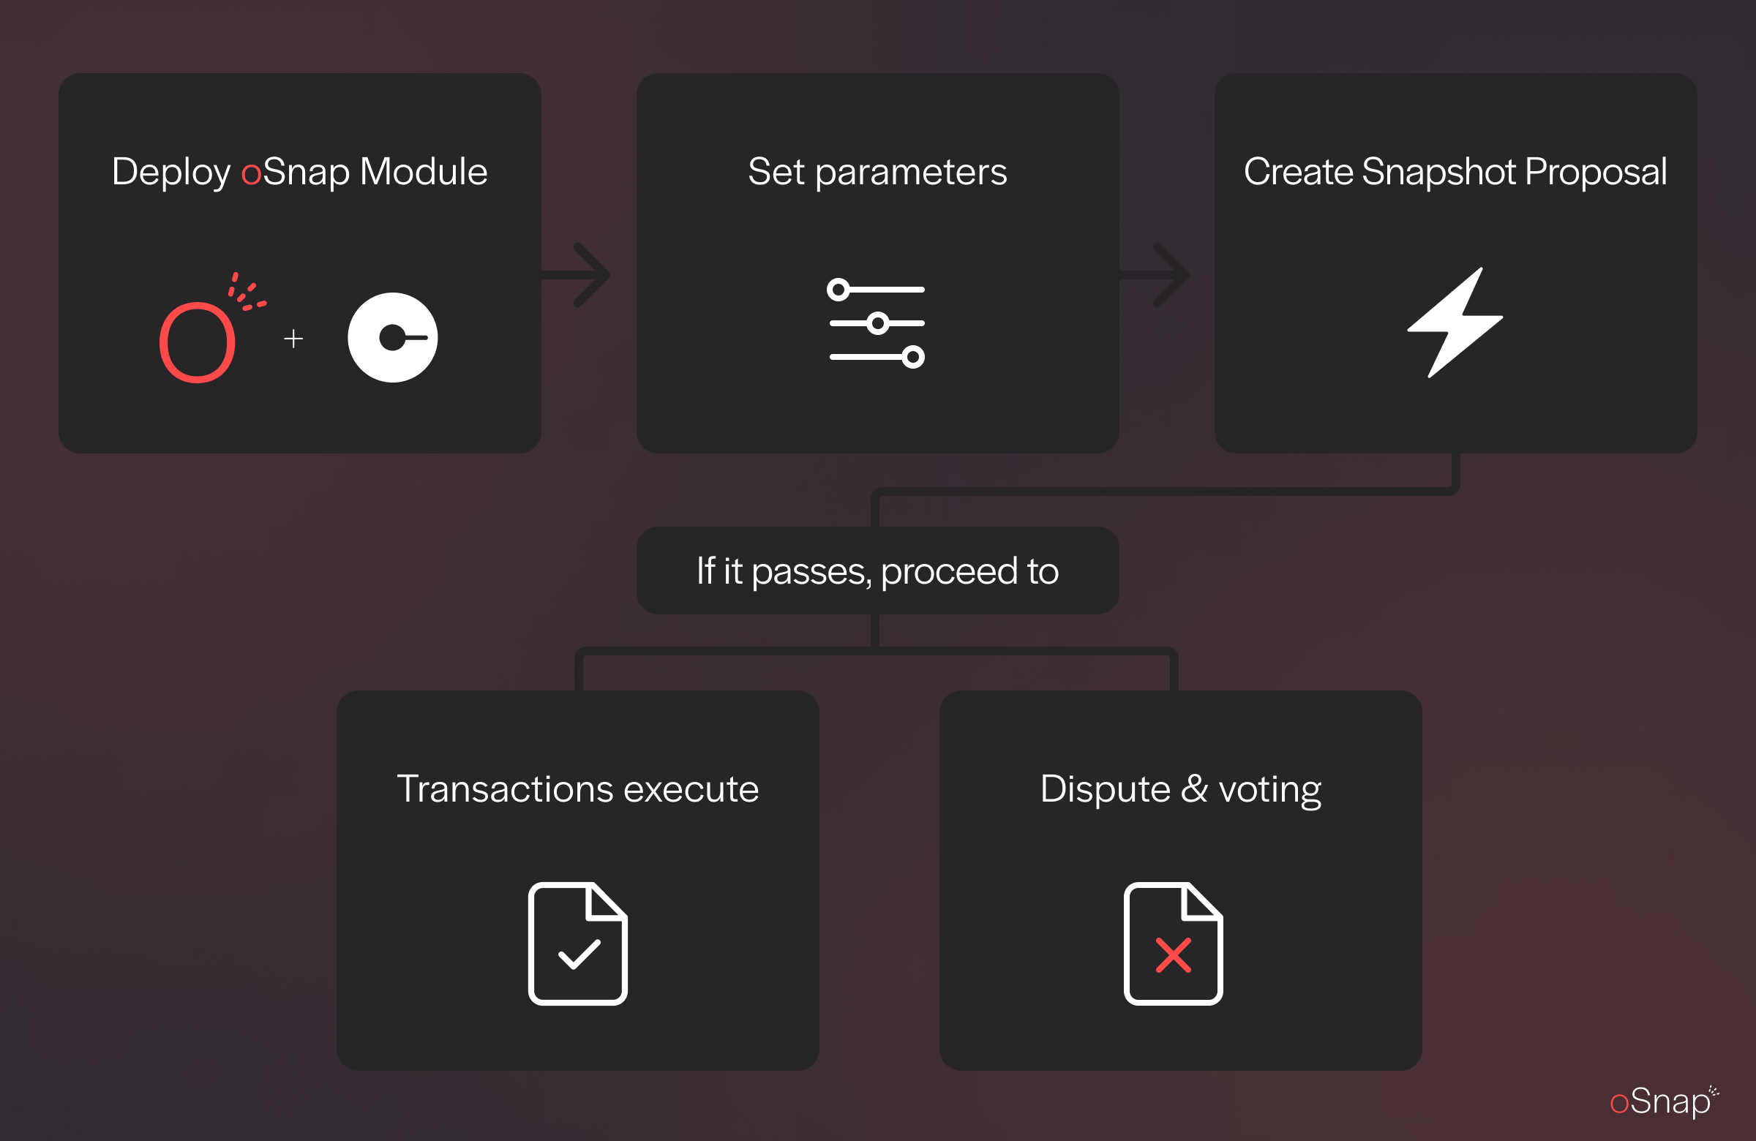



Notes:
To enable the suggested process, we’ve chosen OP Attestation, oSnap, and Gnosis Safe.
These tools will help the post-hackathon development journey, guaranteeing a smooth and secure experience.

Slide 8

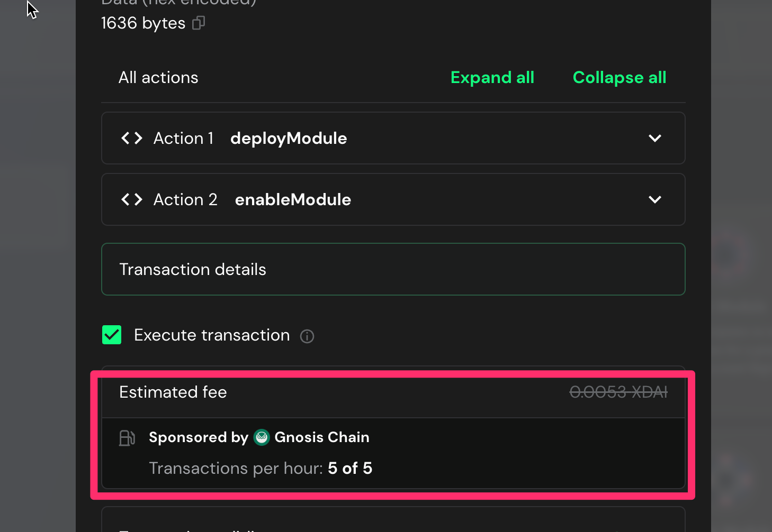
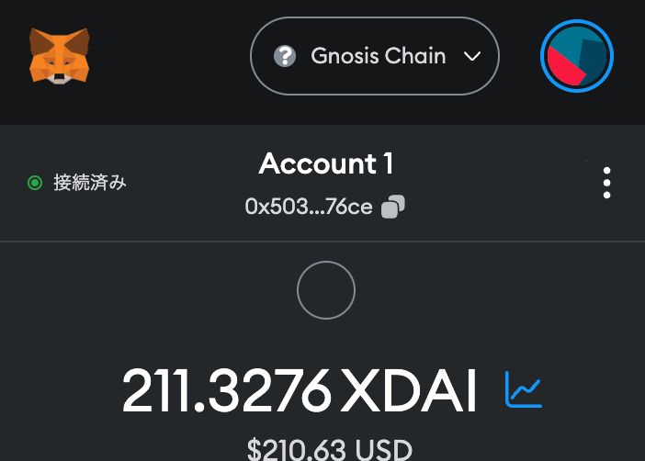
Gnosis Chain is Good Donation Environment
Build on Gnosis Chain
Notes:
We developed on Gnosis Chain . Because it stands out in the blockchain space from view point of its cost-effective safe usage
especially usd-pag, gas pricing. These features make our product more trust one.

Slide 9
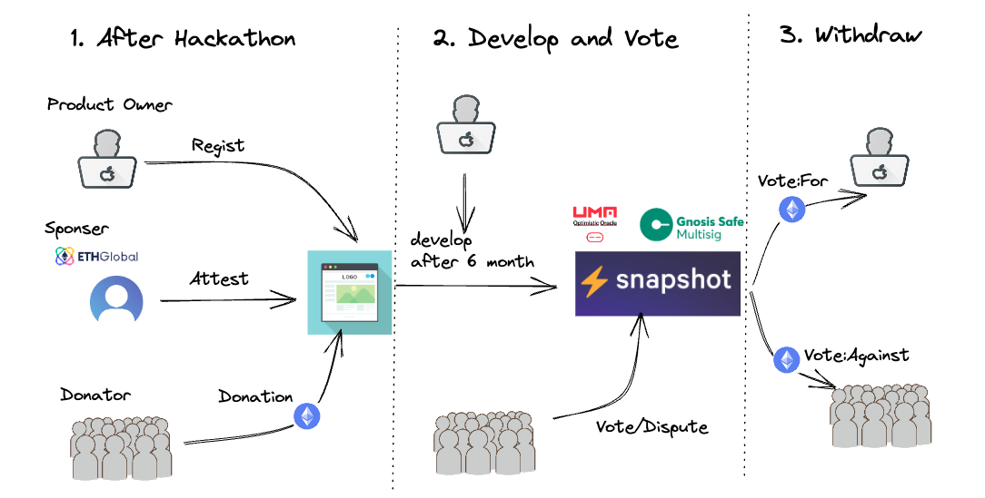
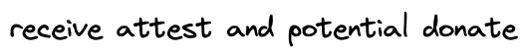
Notes:
Applying these tools to the flow, we can visualize the process as follows:

Slide 10

let’s explain the attestation part
Notes:
First, let’s explain the attestation part. In this phase, the goals are setting milestones, obtaining attestations from sponsors, and receiving donations. Here’s a breakdown of each step:

Slide 11
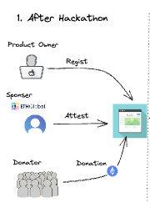
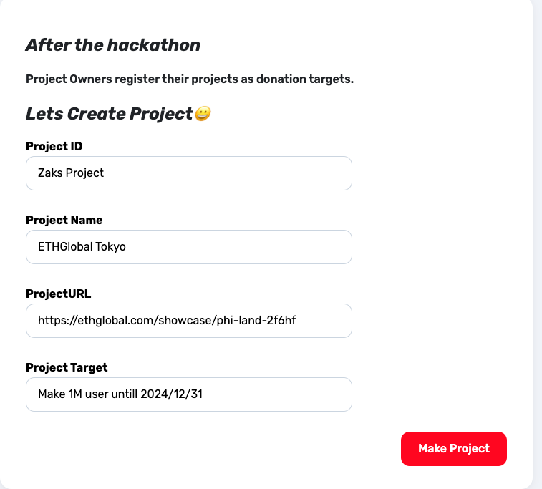

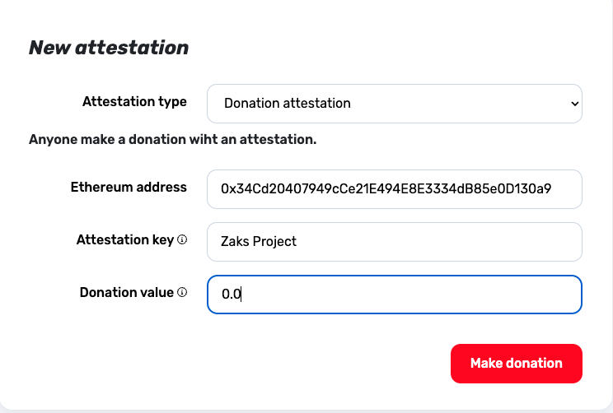
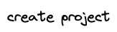
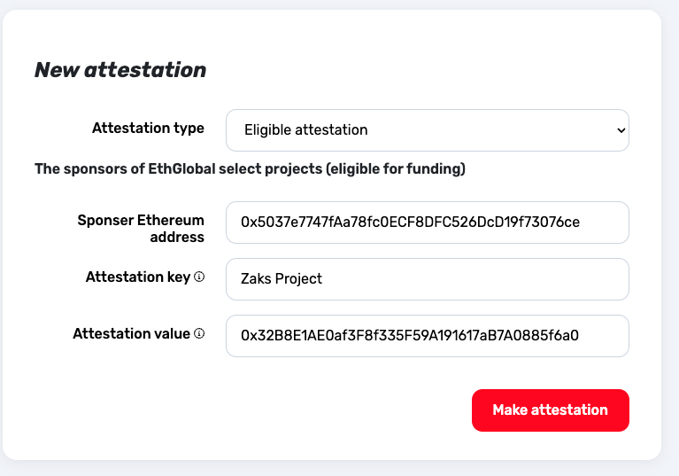

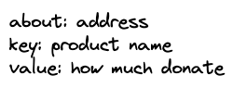
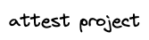
Notes:
Milestone Setting: The project owner determines the project milestones and their corresponding deadlines.
Attestation from Sponsors: Using OP Attestation, sponsors or investors can write attestations for the project using their Ethereum addresses.
Donations: donator can confidently donate to the project they

Slide 12

Notes:
In this phase, sponsors and donators, will help sustain momentum and give them feedback.

Slide 13
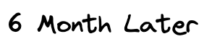
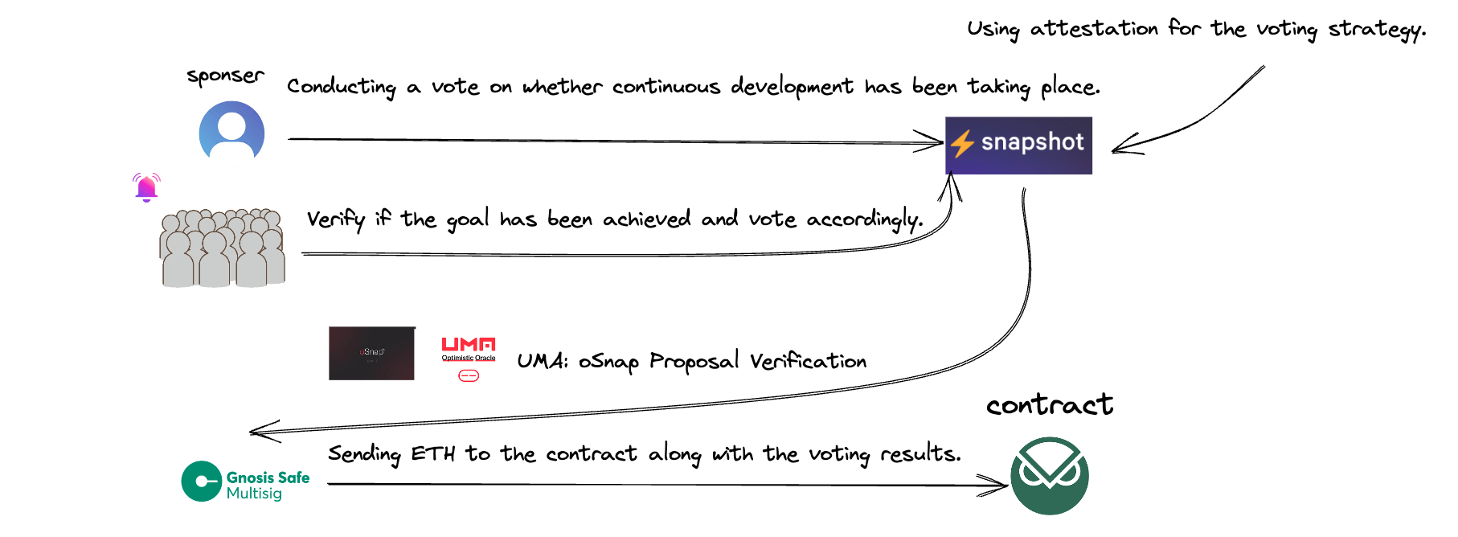
Notes:
As the deadline, oSnap’s will be used for donors to decide whether the milestone is reached. Or not.
The voting outcomes are confirmed through UMA/oSnap, and once voting is finished, donation transer from the Gnosis Safe ,
(oSnap offers a smooth solution for handling these procedures, guaranteeing an effective and transparent system for milestone evaluation and fund distribution. This method enables project teams and backers to trust the development progress and the appropriate allocation of resources.)

Slide 14
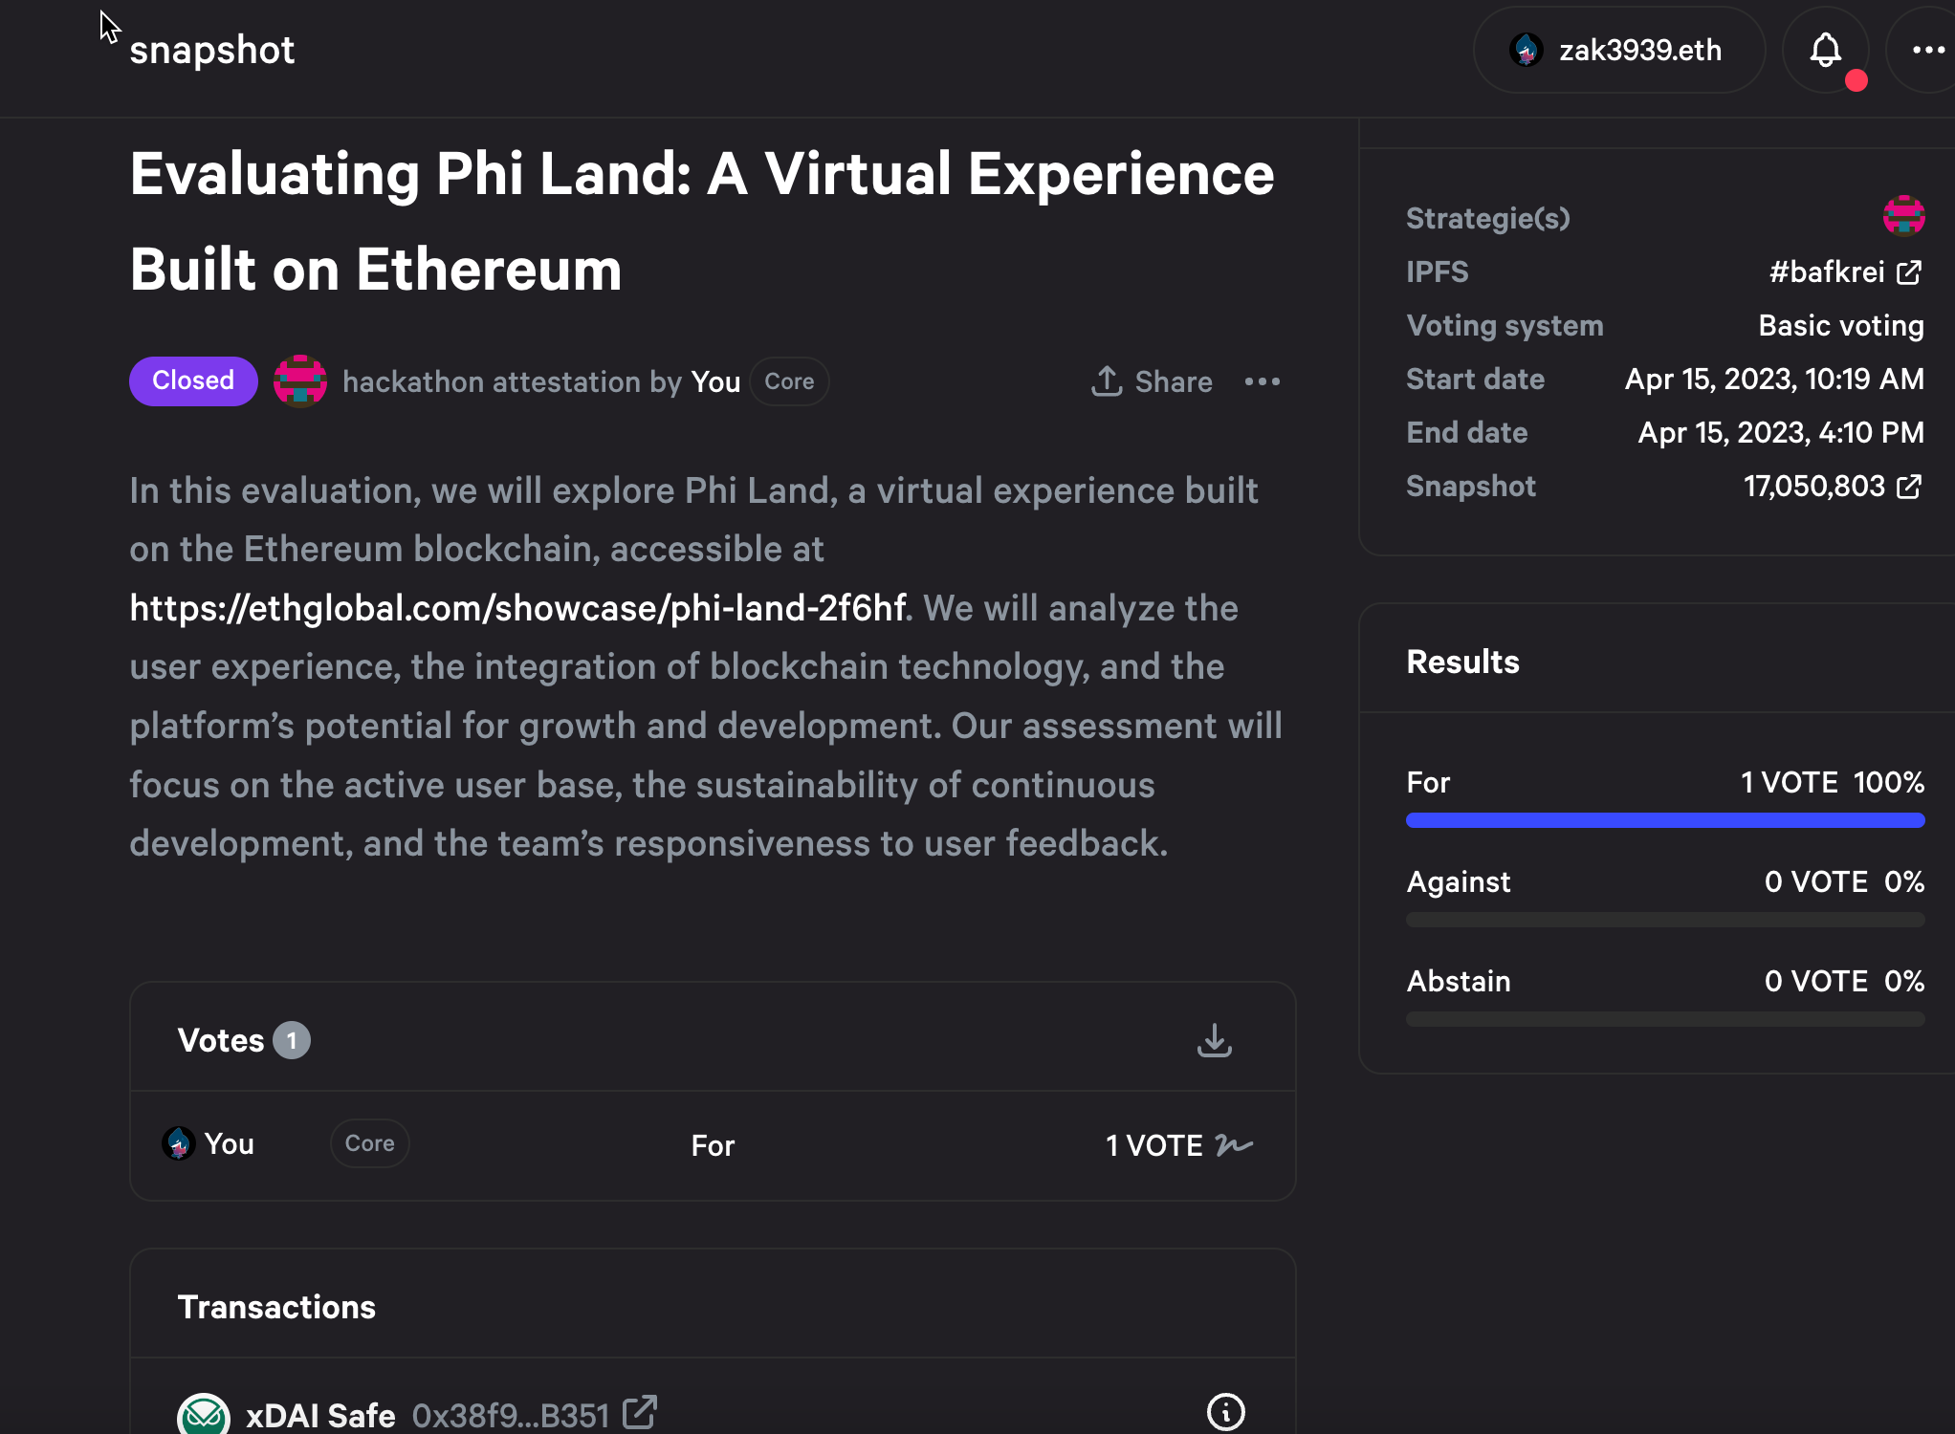
Notes:
In snapshot phase, donator can choose donate or withdraw.

Slide 15

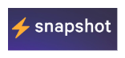
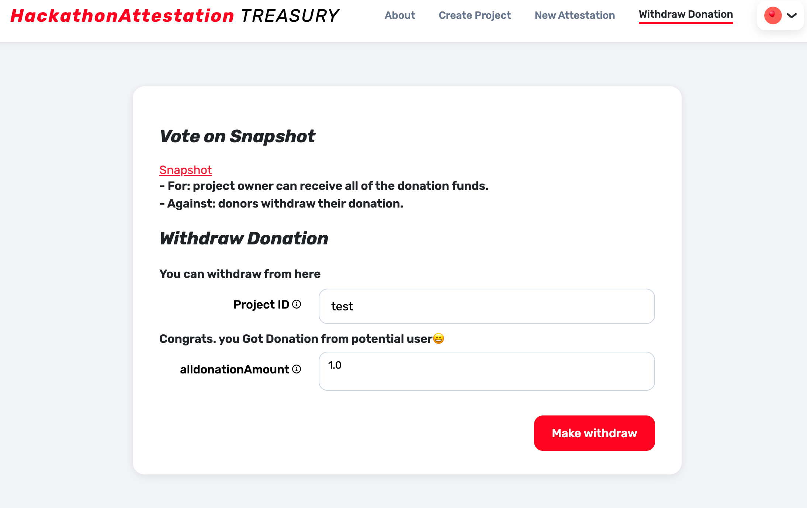
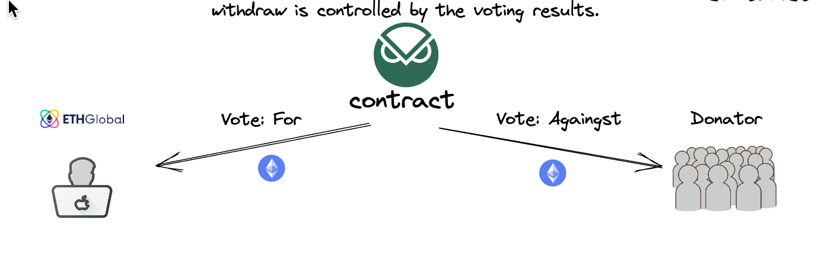
Notes:
If the vote is successful, the product owner can obtain the donation. However, if the vote fails, the donors can individually withdraw their contributions.

Slide 16

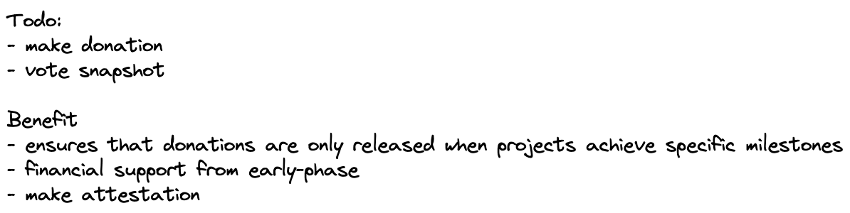

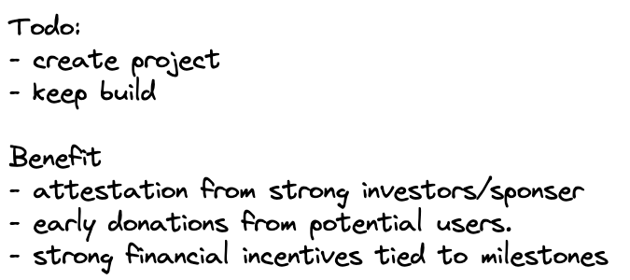
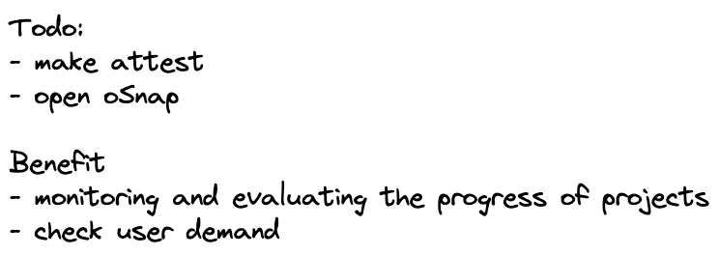
Notes:
In summary, this process offers advantages for all parties involved:
Sponsors can efficiently assess projects,
Project owners try to work hard for reaching milestones and get donation.
Donors can feel transparency and donate from early-phase
So, we create a win-win situation for all parties involved, promoting successful post-hackathon

Slide 17
Thank you for listening
We believe
hackathons generate numerous promising projects with immense potential.
Our aim is
expanding and becoming more impactful by offering a supportive ecosystem
that encourages success and guarantees transparent donation.
.
Notes:
During this hackathon, we’ve suggested this process and focused on creating the contracts and front-end elements. We believe that hackathons generate numerous promising projects with immense potential. Our aim is to aid these projects in expanding and becoming more impactful by offering a supportive ecosystem

Slide 18
OP Attestation: “Sponsors/Investors” can make attestations about project owners with their Ethereum addresses.
This process validates the project’s credibility and ensures that only trustworthy projects can receive donations.
oSnap:
Our product leverages oSnap’s benefits, such as decentralization, security, flexibility, and interoperability,
to facilitate an efficient and reliable donation system.
Donations are only released when projects “achieve specific milestones”
Gnosis Safe:
This platform enables secure funds management,
ensuring that “donations are safely” held until projects meet their milestones.
Notes:
OP Attestation: Sponsors and investors can vouch for project owners’ credibility using attestation
.oSnap establish an effective and dependable donation system by UMA based execute. Donations are disbursed only when projects reach particular milestones.
Gnosis Safe: Gnosis Safe makes sure of secure funds management, safeguarding donations until project milestones are achieved.

